Slide 1
Chapter 16 – IP Security
Notes:
Opening quote.

Slide 2
IP Security
Some applications have built-in security mechanisms
eg. S/MIME, PGP, Kerberos, SSL/HTTPS
There are many applications without built-in security mechanisms.
IP-level security can be applied to provide security to all applications with/without security features.
Notes:
The Internet community has developed application-specific security mechanisms in a number of application areas, including electronic mail (S/MIME, PGP), client/server (Kerberos), Web access (Secure Sockets Layer), and others. However users have some security concerns that cut across protocol layers. By implementing security at the IP level, an organization can ensure secure networking not only for applications that have security mechanisms but also for the many security-ignorant applications.

Slide 3
IPSec
IP Security provides
authentication
confidentiality
key management
It provides secure communications across LANs, private and public WANs and Internet.
Notes:
IP-level security encompasses three functional areas: authentication, confidentiality, and key management. The authentication mechanism assures that a received packet was transmitted by the party identified as the source in the packet header, and that the packet has not been altered in transit. The confidentiality facility enables communicating nodes to encrypt messages to prevent eavesdropping by third parties. The key management facility is concerned with the secure exchange of keys. IPSec provides the capability to secure communications across a LAN, across private and public WANs, and across the Internet.

Slide 4
Authentication ensures that
(authenticates source) packet is really coming from the source mentioned in the packet header, not from elsewhere
(Verifies integrity) Packet is not altered in the transit
Confidentiality secures packet content by encrypting it.
Key management securely exchanges keys

Slide 5
IP security is implemented in firewalls / routers through which entire traffic is routed in & out of corporate network.
It is implemented below the transport layer, so it is transparent to all applications
It does not affect s/w in upper layers
It is transparent to end users

Slide 6
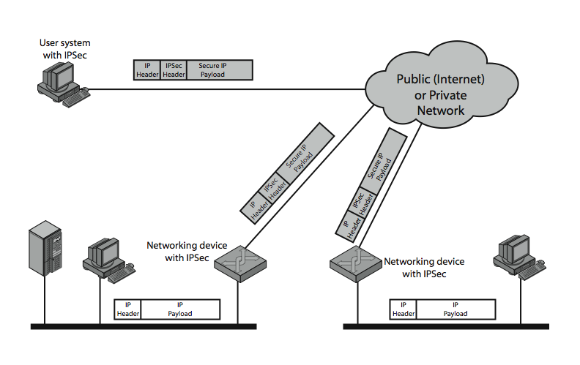
IPSec Scenerio
Notes:
Stallings Figure 16.1 illustrates a typical IP Security scenario. An organization maintains LANs at dispersed locations. Nonsecure IP traffic is conducted on each LAN. For traffic offsite, through some sort of private or public WAN, IPSec protocols are used. These protocols operate in networking devices, such as a router or firewall, that connect each LAN to the outside world. The IPSec networking device will typically encrypt and compress all traffic going into the WAN, and decrypt and decompress traffic coming from the WAN; these operations are transparent to workstations and servers on the LAN. Secure transmission is also possible with individual users who dial into the WAN. Such user workstations must implement the IPSec protocols to provide security.

Slide 7
IP Security Architecture
IP Sec is mandatory in IPv6, optional in IPv4
It has two security header extensions:
Authentication Header (AH) for authentication
Encapsulating Security Payload (ESP) for encryption
Notes:
The IPSec specification has become quite complex. The IPSec specification consists of numerous documents. The most important of these,issued in November of 1998, are
• RFC 2401: An overview of a security architecture
• RFC 2402: Description of a packet authentication extension to IPv4 and IPv6
• RFC 2406: Description of a packet encryption extension to IPv4 and IPv6
• RFC 2408: Specification of key management capabilities
In addition to these four RFCs, a number of additional drafts have been published by the IP Security Protocol Working Group set up by the IETF. The documents are divided into seven groups.
Support for these features is mandatory for IPv6 and optional for IPv4.
In both cases, the security features are implemented as extension headers that follow the main IP header. The extension header for authentication is known as the Authentication Header (AH); that for encryption is known as the Encapsulating Security Payload (ESP) header.

Slide 8
IPSec Services:
Access control
Connectionless integrity
Data origin authentication
Rejection of replayed packets
Confidentiality (encryption)
Limited traffic flow confidentiality
Notes:
IPSec provides security services at the IP layer by enabling a system to select required security protocols, determine the algorithm(s) to use for the service(s), and put in place any cryptographic keys required to provide the requested services. The security services supported are as shown above. See Stallings Table 16.1 for the services provided by AH & ESP respectively. For ESP, there are two cases: with and without the authentication option. Both AH and ESP are vehicles for access control, based on the distribution of cryptographic keys and the management of traffic flows relative to these security protocols.

Slide 9
Security Associations (SA)
SA is a one-way relationship between sender & receiver that affords security for traffic flow
SA is defined by 3 parameters:
Security Parameters Index (SPI)
IP Destination Address
Security Protocol Identifier
has a number of other parameters:
seq no, AH inf ESP info, lifetime of SA etc
Notes:
A key concept that appears in both the authentication and confidentiality mechanisms for IP is the security association (SA). An association is a one-way relationship between a sender and a receiver that affords security services to the traffic carried on it. If a peer relationship is needed, for two-way secure exchange, then two security associations are required. Security services are afforded to an SA for the use of AH or ESP, but not both.
A security association is uniquely identified by three parameters:
• Security Parameters Index (SPI): A bit string assigned to this SA and having local significance only
• IP Destination Address: this is the address of the destination endpoint of the SA
• Security Protocol Identifier: This indicates whether the association is an AH or ESP security association.
A SA may also have a number of other parameters. In each IPSec implementation, there is a Security Association Database that defines the parameters associated with each SA.

Slide 10
Authentication Header (AH)
AH provides support for data integrity & authentication of IP packets
end system/router can authenticate user/app
Authentication prevents address spoofing attacks and replay attack.
Authentication is based MAC
HMAC-MD5-96 or HMAC-SHA-1-96
parties must share a secret key
Notes:
The Authentication Header provides support for data integrity and authentication of IP packets.The data integrity feature ensures that undetected modification to a packet’s content in transit is not possible. The authentication feature enables an end system or network device to authenticate the user or application and filter traffic accordingly; it also prevents address spoofing attacks and replay attacks. Authentication is based on the use of a message authentication code (MAC), hence the two parties must share a secret key. AH supports MACs using HMAC-MD5-96 or HMAC-SHA-1-96. Both of these use the HMAC algorithm , the first with the MD5 hash code and the second with the SHA-1 hash code. In both cases, the full HMAC value is calculated but then truncated by using the first 96bits, which is the default length for the Authentication Data field.

Slide 11
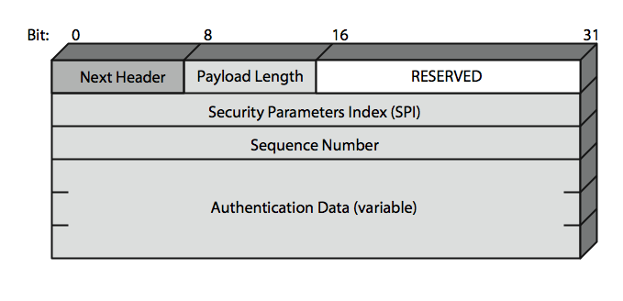
Authentication Header
Notes:
Stallings Figure 16.3 shows the Authentication Header fields:
• Next Header (8 bits): Identifies the type of header immediately following this header
• Payload Length (8 bits): Length of Authentication Header in 32-bit words, minus 2.
• Reserved (16 bits): For future use
• Security Parameters Index (32 bits): Identifies a security association
• Sequence Number (32 bits): A monotonically increasing counter value
• Authentication Data (variable): A variable-length field (must be an integral number of 32-bit words) that contains the Integrity Check Value (ICV), or MAC,for this packet

Slide 12
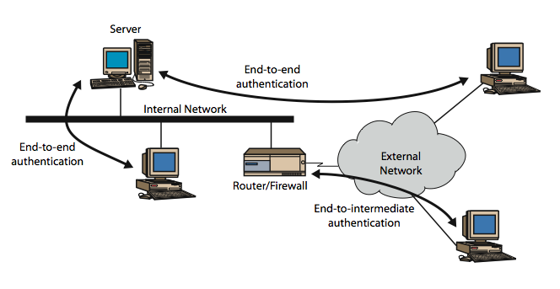
Transport & Tunnel Modes
Notes:
Stallings Figure 16.5 shows the difference between end-to-end (transport) mode and end-to-intermediate (tunnel) mode.
Transport mode provides protection primarily for upper-layer protocol payloads, by inserting the AH after the original IP header and before the IP payload. Typically, transport mode is used for end-to-end communication between two hosts.
Tunnel mode provides protection to the entire IP, after the AH or ESP fields are added to the IP packet, the entire packet plus security fields is treated as the payload of new “outer”IP packet with a new outer IP header. Tunnel mode is used when one or both ends of an SA are a security gateway, such as a firewall or router that implements IPSec.

Slide 13
Transport mode is used for end to end communications
Eg. Client to server or two workstations
Tunnel mode is used when one or both ends of an SA is a security gateway such as firewall/router that implements IPSec.
Eg., used in VPNs, gateway to gateway security

Slide 14
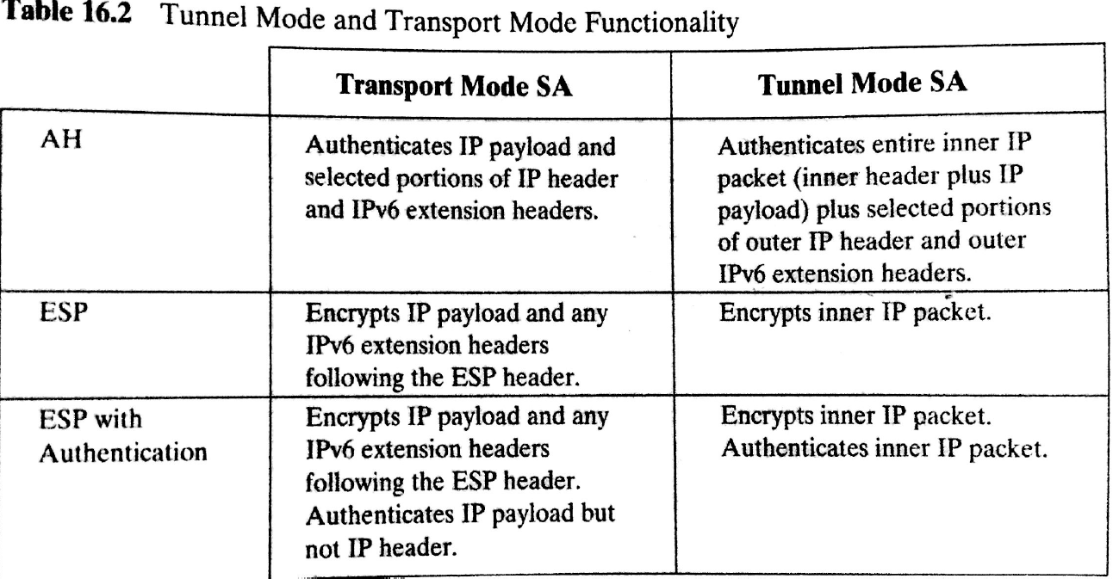

Slide 15
Encapsulating Security Payload (ESP)
provides message content confidentiality & limited traffic flow confidentiality
can optionally provide the same authentication services as AH
supports range of ciphers, modes, padding
incl. DES, Triple-DES, RC5, IDEA, CAST etc
CBC & other modes
padding needed to fill blocksize, fields, for traffic flow
Notes:
The Encapsulating Security Payload provides confidentiality services, including confidentiality of message contents and limited traffic flow confidentiality. As an optional feature, ESP can also provide an authentication service, with the same MACs as AH. ESP supports range of ciphers, modes, and padding, as shown.

Slide 16
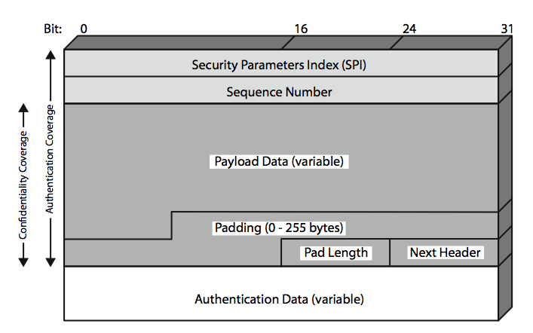
Encapsulating Security Payload
Notes:
Stallings Figure16.7 shows the format of an ESP packet. It contains the following fields:
• Security Parameters Index (32 bits): Identifies a security association
• Sequence Number (32 bits): A monotonically increasing counter value; this provides an anti-replay function ,as discussed for AH
• Payload Data (variable): This is a transport-level segment (transport mode) or IP packet (tunnel mode) that is protected by encryption
• Padding (0–255 bytes): for various reasons
• Pad Length (8 bits): Indicates the number of pad bytes immediately preceding this field
• Next Header (8 bits): Identifies the type of data contained in the payload data field by identifying the first header in that payload
• Authentication Data (variable): A variable-length field that contains the Integrity Check Value computed over the ESP packet minus the Authentication Data field

